Slide 1
Cell Theory Timeline 8-7
Make notes to help you summarize your thinking.
Read pages 7, 18-20 from your SciencePower 8 textbook
AND Part 3 research
2) Watch a video about the cell
theory (Through the Lens,
Discovery Education)
3) Read the article provided.
Due: Friday, sticky notes or other paper (Thurs no class)
2) Due: Friday per, 6,7 class time
3) Due Friday per 6,7 class time
Final Timeline due Monday
Sept 26, Day 3 per 4

Slide 2
CELLS
What are they?

Slide 3
What is a cell?
A cell is the smallest unit of an organism that can carry on life's functions.
Cells are the building blocks of organisms.
Each cell must be able to do jobs (functions)to keep it alive such as growing, developing, and using energy. They also must be able to reproduce to make more cells.

Slide 4
CELLS
How were they discovered?

Slide 5
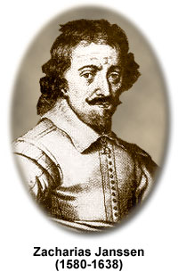
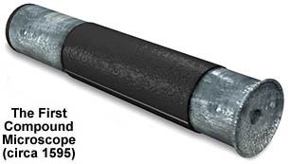
Who discovered cells?
There were many scientists who were involved in the discovery.
Its started with Hans and Zacharias Janssen. This father and son team created the first compound ( 2 lens) microscope.
They however did not use this microscope to observe cells.

Slide 6
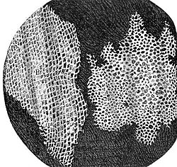
Then there was Robert Hooke in 1665
Robert Hooke was an English scientist that looked at cork under a compound microscope.
He observed little empty boxes that he called CELLS because they reminded him of rooms where monks lived.
No one knows what he looks like. His portrait has not been seen since 1710.
Hooke’s drawing of cork

Slide 7
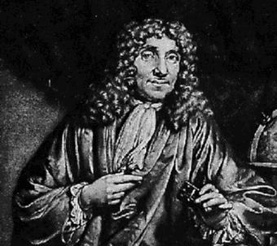
Anton van Leeuwenhoek
Had a drapery business and would use a simple lens to examine cloth.
He would use his lens to examine nature.
He noticed small living things living in a drop of pond water. He called these creatures “animalcules”.

Slide 8
Matthias Schleiden
German botanist (scientist that studies plants) who viewed different parts of plants under a microscope such as leaves, stem, and roots.
He discovered that plants were made up of cells.

Slide 9
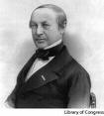
Theodor Schwann
Was a German zoologist (scientist that studies animals) who viewed animal parts under a microscope and discovered that animals were made up of cells.

Slide 10
The observations of Francesco Redi and many other scientists led to the creation of the cell theory.
The cell theory has 4 main ideas:
1. All organisms are made up of one or more cells.
2. The cells in all organisms have the same basic parts and the same job to do.
3. All cells come from cells that already exist.
4. The health of the organism depends on the health of the individual cells.

Slide 11
Notes:
Cells are the building blocks of organisms. Each cell must be able to do jobs to keep the organism alive.
Cells were first discovered by Robert Hooke in 1665. He looked at a piece of cork under a microscope and saw little empty boxes which he called cells

