Slide 1
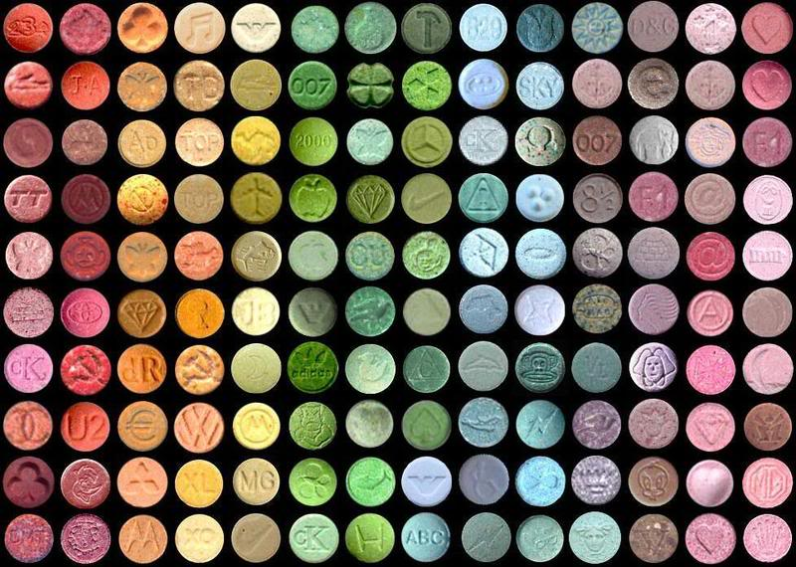
ECSTASY
By: Erik and Emily

Slide 2
Street Names
Molly
Egg Rolls
Malcolm
Beans
Doves
Disco Biscuits
Dancing Shoes
Scooby Snacks
Thizz

Slide 3
SIDE EFFECTS
SHORT TERM-
Paranoia
False sense of affection
Involuntary teeth clenching
Impaired judgement
Nausea
Faintness, chills or swelling
Blurred vision
Long term-
It is as if the brain switchboard was torn apart, then rewired backwards
Psychosis
Hemorrhaging
Convulsions
Death
Brain damage affecting thoughts and memory
Depression, anxiety, memory loss
Kidney failure

Slide 4
HOW IT ENTERS THE BODY
I gets into you system through many different ways like 100mg to 180mg pills. They are also colourful and often have pictures. It is also rarely taken in the form of snorting and injection.

Slide 5
WHY PEOPLE CHOSE TO USE IT
There are probably very many reasons why people use this drug but some of the main reasons are peer pressure, used to synthesize other pharmaceuticals, and for mental health

