Slide 1
Human Reproduction
Male and Female Gametes
(Sex Cells)

Slide 2
Size of Human Cells & Gametes

Slide 3
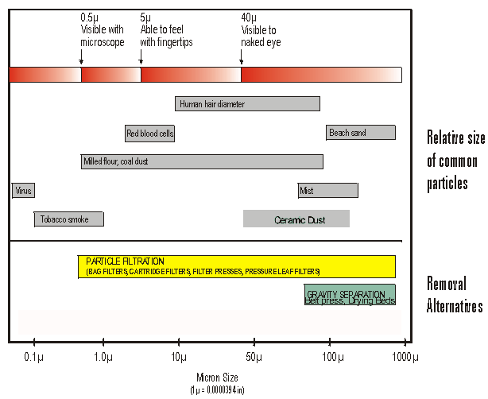
How big are cells?
Microscopic (mostly)
Measured in microns µm
(micrometers)
A µm is one millionth of a meter =
10⁻⁹ m = one thousandth of 1 mm.

Slide 4
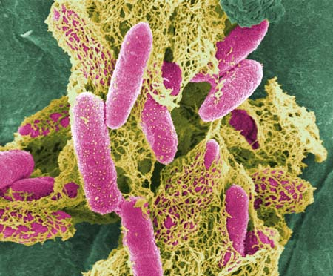
How big are cells?
Bacteria e.g. Eschericia coli (aka E.coli)
Size=1 µm by 3 µm

Slide 5
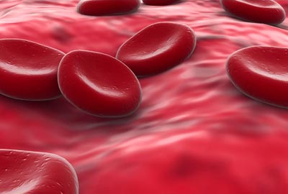
How big are cells?
Human red blood cell = 8 µm in diameter

Slide 6
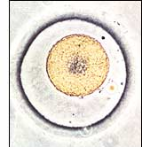
How big are cells?
Largest cell on the human body = egg cell (also called an ovum)
Size= 1000 µm in diameter
(1 mm)

Slide 7
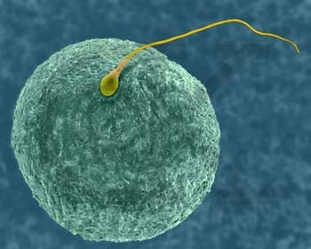
How big are cells?
Smallest cell in the human body =
sperm cell.

Slide 8
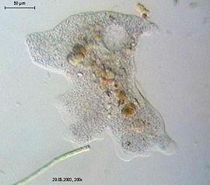
How big are cells?
Largest cell with a metabolism =
Chaos chaos
Size=1-5 mm in length.
common name =
Giant Amoeba
Chaos diffluens, is an amoeba closely related to the giant amoebae

Slide 9
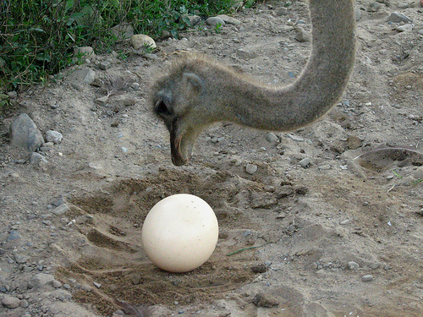
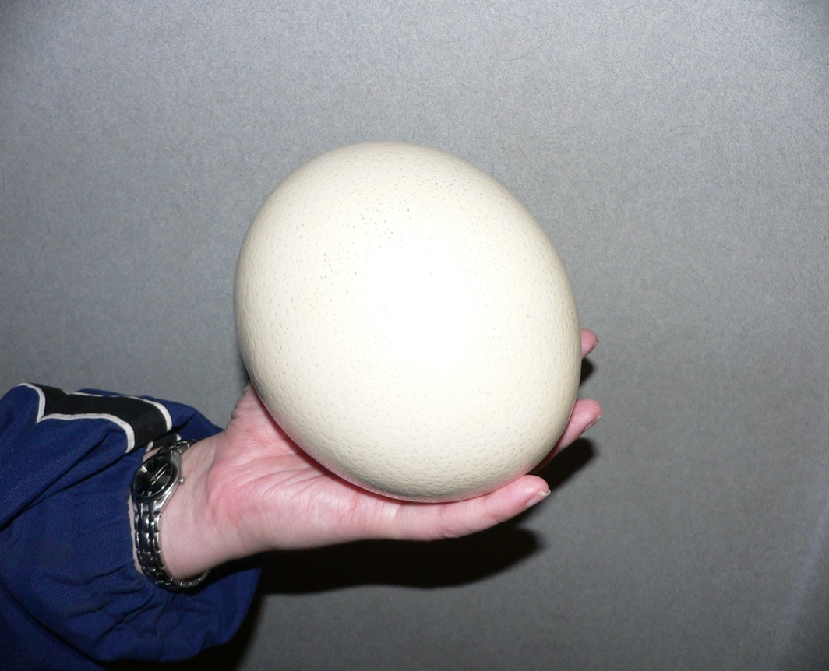
How big are cells?
Largest cell = yolk of an ostrich egg

Slide 10
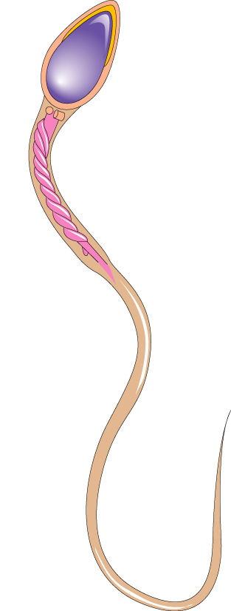
Male Sperm Cell
A mature sperm cell consists of:
a head, haploid
a midpiece, energy-releasing mitochondria
a tail, which propels the cell forward to the journey toward the egg
Head
Nucleus
Midpiece
Mitochondria
Tail
Notes:
The sperm is the male gamete, or sex cell.

Slide 11
Summary Of Gametes
Gametes are sex cells
Egg cell is largest in the human body
Egg cells is also called Ovum
Sperm cells are the smallest in the human body
Testes are the organs where sperm is made + stored
Ovaries are the organs where ovum are matured and released from

Slide 12
How Does the Body Know What to Do?
Hormones

Slide 13
How Do Hormones Work?
Often, there will be hormones from our brain that “tell” other organs (like testes or ovaries) what to do or what not to do
Then the organs themselves produce hormones that “tell” other parts (like the uterus) what to do.
Positive feedback: actions are stimulated
Negative feedback: actions are prevented
Recall that the ovaries are the organs in which female sex cells (eggs) grow.
Testes are the organs in which male sex cells (sperm) grow.

Slide 14
Hormones –Male Reproductive System
The pituitary gland at the base of the brain produces FSH (follicle stimulating hormone). The blood carries it to the gonads. It signals two changes:
A. the sperm-producing tubules to produce sperm cells daily
for the rest of their lives.
B. the testes (plural of testicles) are stimulated to make a
hormone called testosterone, which directs the
development of secondary sexual characteristics such as
1) deepening of the voice
2) production of hair on the underarms, chest, and
pubic region.
3) broadening of the shoulders

Slide 15
Hormones–Female Reproductive System
Female Reproductive System
The pituitary gland at the base of the brain produces follicle stimulating hormone (FSH). The blood carries it to the gonads where it stimulates two changes:
1. ovaries are stimulated to begin maturing so that they can release eggs. Generally, one egg is released each month. After about the age of 45-50 years of age, a woman stops releasing a monthly egg because her estrogen levels drop. This change in the hormones is called menopause.
2. ovaries are stimulated to produce estrogen, which directs the development of secondary sexual characteristics such as
a) fat deposits in the breasts and hips
b) growth of hair in the pubic region and underarms

Slide 16
Answers- Sex Cells A Different Story
1. body cells 2. sex cells 3. body cells
4. mitosis 5.eggs 6. sperm
7. Chromosomes 8. 23 9. 78
10. 39 11. 46 12. The size and complexity of an organism has no relationship with the number of chromosomes (bigger does not necessarily mean more chromosomes) 13. Body cells have half the number of chromosomes as sex cells. We call the number of chromosomes in body cells the HAPLOID number and the number of chromosomes in sex cells the DIPLOID number.

Slide 17
Answers – Meiosis (Partner guessing)
Different
Egg
Sperm
Haploid
Sex cell and GAMETE are BOTH correct. Make sure you have both.

Slide 18
Assignment for Period 6
Read p. 44-47, 50
Complete p. 50 #1 b, 1c, 2 - 7

Slide 19
Agreements When Discussing or Drawing Reproductive System Concepts
The human body is a grand accumulation of cells which function individually for a common goal of a health
Respecting it is an essential part of studying it
We agree to *avoid slangs
*not mock the parts (structures)
*not make sexual innuendos
(some people find them offensive)
*avoid personification

Slide 20
Female Reproductive System

Slide 21
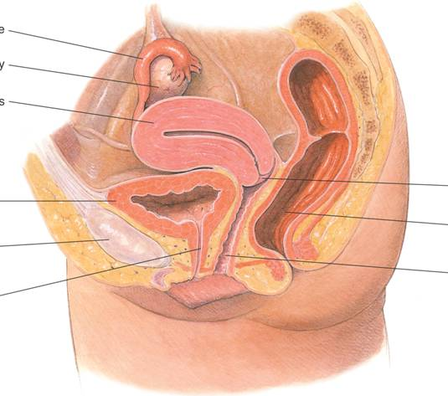
The Female Reproductive System
Fallopian tube
Ovary
Uterus
Cervix
Urinary bladder
Rectum
Pubic bone
Vagina
Urethra
Notes:
The main function of the female reproductive system is to produce ova. The ovaries are the main organs of the female reproductive system.
Egg Development
Each ovary contains about 400,000 primary follicles, which are clusters of cells surrounding a single egg.
The follicle helps an egg mature for release into the reproductive tract, where it can be fertilized.
Eggs develop within their follicles.
When a follicle has matured, its egg is released in a process called ovulation.
The follicle breaks open, and the egg is swept from the ovary into one of the two Fallopian tubes.
While in the Fallopian tube, an egg can be fertilized.
After a few days, the egg passes from the Fallopian tube into the uterus.
If the egg is not fertilized it passes through the cervix, and finally out of the vagina.
The vagina leads to the outside of the body.

Slide 22
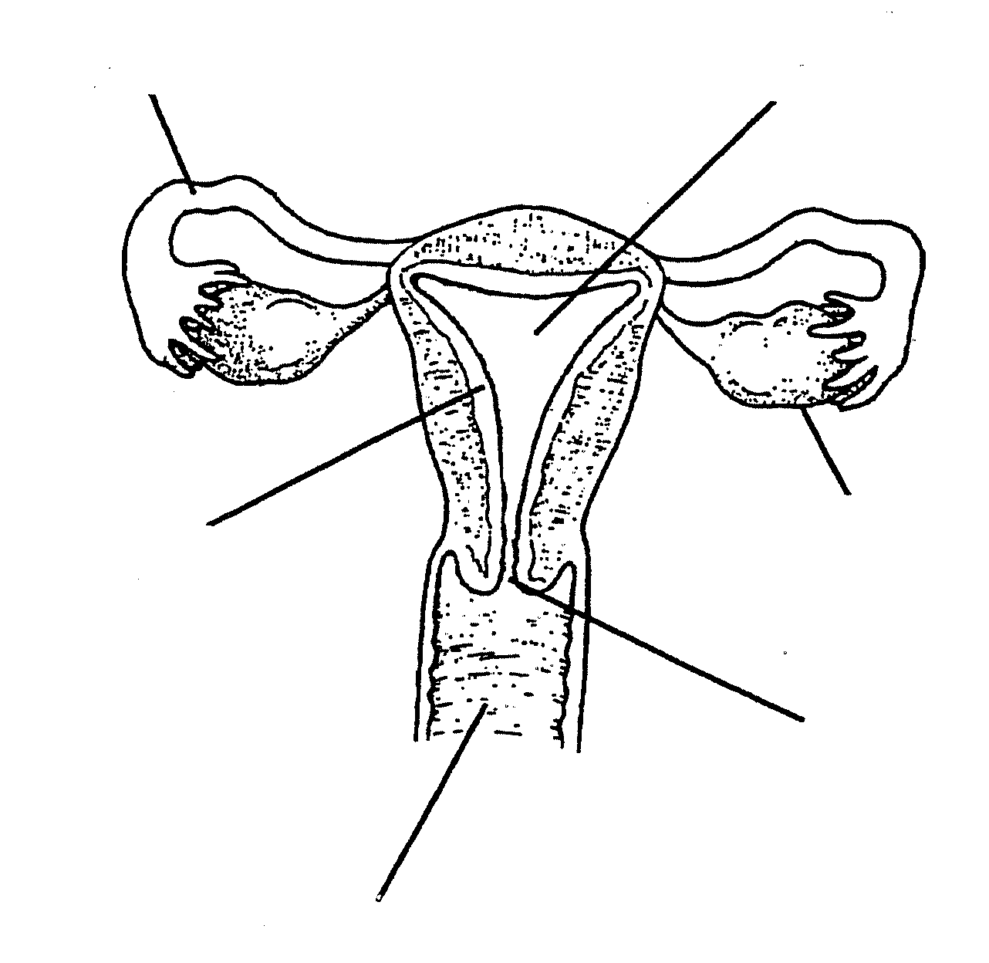
Label 6 parts
ovary
uterus
cervix
oviducts /
Fallopian tubes
vagina

Slide 23
Miracle of Life – Female Gamete Production
http://www.bing.com/videos/search?q=nova+mircle+of+life&docid=4895439273135307&mid=5B9AD0ABB338FCBA7B5F5B9AD0ABB338FCBA7B5F&view=detail&FORM=VIRE1#view=detail&mid=5B9AD0ABB338FCBA7B5F5B9AD0ABB338FCBA7B5F
BEGIN at 6:06

Slide 24
Miracle of Life Summary – Female Gamete Production
Eggs (ova)are produced in the ovary
Only 1 egg matures per month
They move down through the Fallopian tubes which are 2 human hairs wide
The lining of the uterus is being prepared to receive the egg
The egg is ready to be fertilized by the sperm
If there’s no sperm the egg leaves the body

Slide 25
Male Reproductive System

Slide 26
vas deferens
prostate gland
seminal vesicles
testes
seminiferous tubules
penis
urethra

Slide 27
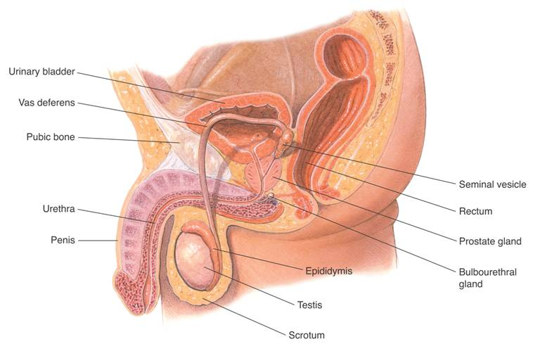
The Male Reproductive System
Urinary bladder
Vas deferens
Pubic bone
Seminal vesicle
Urethra
Rectum
Penis
Prostate gland
Epididymis
Bulbourethral gland
Testis
Scrotum
Notes:
The main structures of the male reproductive system produce and deliver sperm. The main organs of the male reproductive system are the testes. The testes are located in an external sac called the scrotum.
The scrotum is located outside the body cavity, where it is between 1 and 3 degrees cooler than normal body temperature. The lower temperature helps sperm development.
The testes are located in an external sac called the scrotum.
The scrotum is located outside the body cavity, where it is between 1 and 3 degrees cooler than normal body temperature. The lower temperature helps sperm development.
Within each testis are clusters of hundreds of tiny tubules called seminiferous tubules.
The seminiferous tubules are tightly coiled and twisted together.
Sperm are produced in the seminiferous tubules.
Sperm produced in the seminiferous tubules move into the epididymis, where they mature and are stored.
From there, sperm move into a tube called the vas deferens, which extends up from the scrotum into the abdominal cavity.
This merges with the urethra, the tube that leads to the outside of the body through the penis.
Glands lining the reproductive tract produce seminal fluid.
Seminal fluid nourishes sperm and protects them from the acidity of the female reproductive tract.
The combination of sperm and seminal fluid is called semen.

Slide 28
Label 6 parts
urethra
vas deferens
urinary
bladder
testes
penis
scrotum

Slide 29
Add these 2 glands:
prostate
gland
seminal vesicles
A gland secretes fluid. In this case, thick, milk-colored sugar-rich fluid (seminal fluid) is secreted into the vas deferens
Sperm + seminal fluid = semen

Slide 30
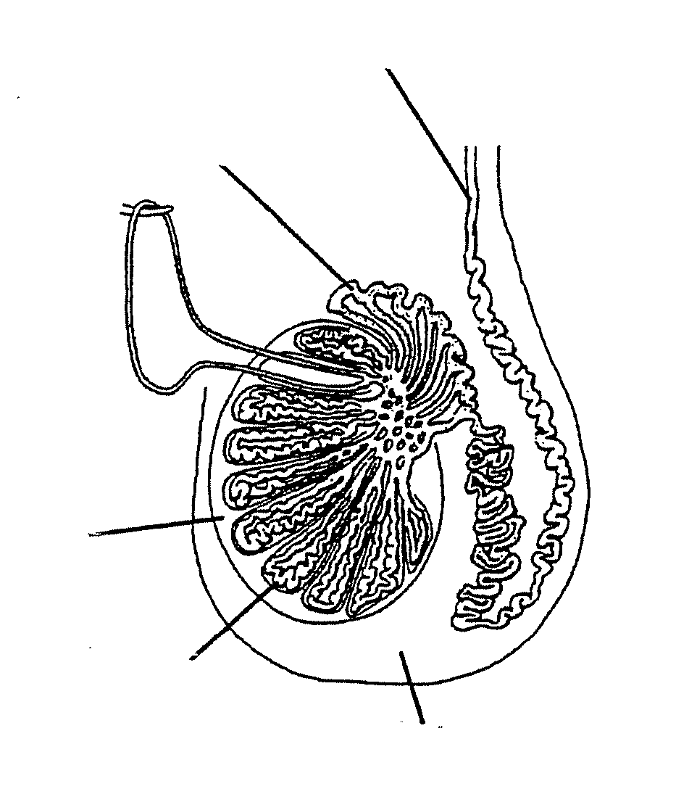
Label 3 parts
*seminiferous
tubules
*testis
*epididymis

Slide 31
Miracle of Life – Male Gamete Production
http://www.bing.com/videos/search?q=nova+mircle+of+life&docid=4895439273135307&mid=5B9AD0ABB338FCBA7B5F5B9AD0ABB338FCBA7B5F&view=detail&FORM=VIRE1#view=detail&mid=5B9AD0ABB338FCBA7B5F5B9AD0ABB338FCBA7B5F
BEGIN at 14:24

Slide 32
Miracle of Life – Male Gamete Production (9-4)

Slide 33
Miracle of Life – Male Gamete Production (9-9)

Slide 34
Male & Female Reproductive System Practice

Slide 35
Label 6 parts
ovaries
uterus
cervix
oviducts / Fallopian tubes
vagina

Slide 36
Label 6 parts
urethra
vas deferens
urinary
bladder
testes
penis
scrotum

Slide 37
Word List for Female Reproduction System
ovaries
oviducts / Fallopian tubes
vagina
uterus
cervix

Slide 38
2 Possibilities for the Egg Cell
Fertilization
Deterioration (death)

Slide 39
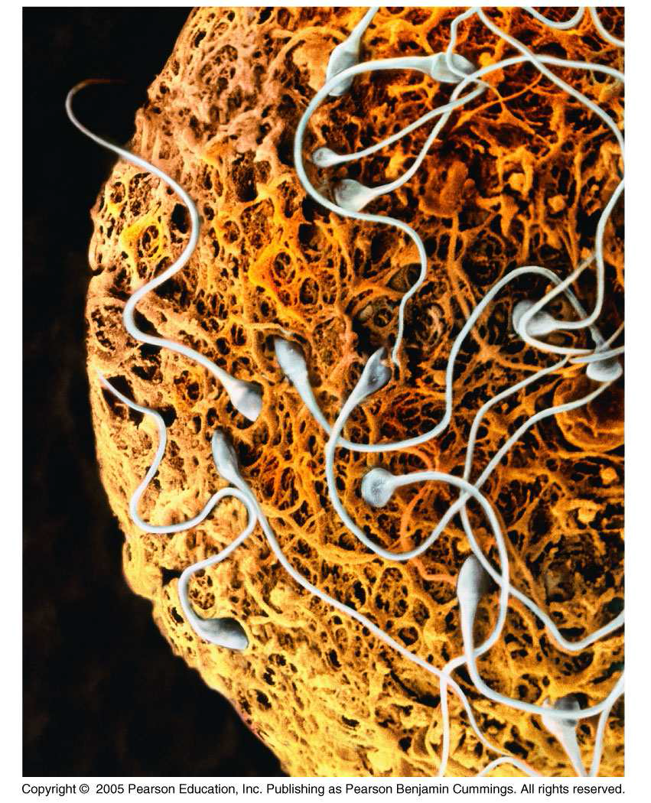
Fertilization
The joining of a haploid egg cell + a haploid sperm cell to form a diploid cell called a ZYGOTE

Slide 40
Menstruation
happens if egg cell is NOT fertilized by a sperm cell OR if the fertilized egg is not able to attach to the uterus lining
The following deteriorates and is shed from the body
egg cell
blood
uterus lining

Slide 41
Menstruation and Fertilization
http://www2.mbusd.org/staff/pware/humanbody.htm

Slide 42
Meiosis
p. 48/49 text – compare mitosis + meiosis visually
Large chart paper *finish drawing (use p. 48)
*answer questions on sheet
Review for Test #2

Slide 43
MEIOSIS
MITOSIS
Similarities

Slide 44
MITOSIS
The process that results in asexual reproduction
(ie no genetic variation-see advantages + disadvantages)
Divide from a somatic/body cell
Produces 2 identical daughter cells
All daughter cells are diploid
(In humans, 2n = 46)
Four phases(PMAT)
One cell division
MEIOSIS
The process that results
in sexual reproduction (much genetic variation – see advantages + disadvantages)
Divide from reproductive cells to produce gametes
Produces 4 non-identical (genetically different) daughter cells
All daughter cells are haploid (In humans, n = 23)
Eight phases
Two cell divisions
Similarities
Both are processes
for cells to divide
Same basic phases
(in meiosis metaphase I,
chromosomes line up
in homologous pairs
instead of single file)

Slide 45
Long Term View 9-4
Test Tuesday Nov 19
Presenting projects
Thursday Nov 14 (2 periods) Josh A, Kenny (pm)
Monday Nov 18 (3 projects) Falicity, Victor (Prezi)
Please add to the Review Sheets
Uterus (under heading female reproductive system)
Urethra, sperm (male reproductive system)

Slide 46
Long Term View 9-9
Test Wednesday Nov 20
Tomorrow (Friday) (2 periods only)
Wednesday (1 period in the morning)
Please add to the Review Sheets
Uterus (under heading female reproductive system)
Urethra, sperm (male reproductive system)
Answers on homework on-line later today

Slide 47
Project: Baby Timeline
9-9
FINISH but KEEP (Project Baby Timeline)
http://people.stfx.ca/x2006/x2006ogg/EDU%20467/Portfolio/Webpage/CellularReproduction.html#6_Interphase
*email your picture of each one (along with website where you found the picture)

