Slide 1
Mon Sept 28 – Fri Oct 2
Mon Sept 28 (Day 3) per 5
DNA “Quiz”
Homework: Cutouts
Watch 2 DNA unzipping videos
Watch MITOSIS video
Tues Sept 29 (Day 4) per 1,7
Weds Sept 30 (Day 5)
Thurs Oct 1 (Day 6) per 7,8
Mon Oct 5 (Day 2) Per 6
Tues Oct 6 (Day 3) per 5

Slide 2
What’s the Difference Between Body Cells And Sex Cells?
Summarize What you have learned so far…
Body Cells
Sex Cells

Slide 3
Cell Cycle

Slide 4
Cycle of ______________’s Life
Cell Cycle

Slide 5
Worksheet “Cell Cycle”

Slide 6
Why would we need or want to “copy” our cells?

Slide 7
When do we want to “copy” our cells?
(9-4)
More cells can do that function (job/ role) for your body
Replace injured cells
Replace dead cells
Increase our size
Collect dead cells on body parts for protection (hair)
To recover from disease
To reproduce our species (meiosis not mitosis)

Slide 8
DNA
holds the genetic codes that determine your traits (hair color, eye color, height, probability for certain diseases)
can be mutated
holds information for directing all cell activities!!

Slide 9
DNA has to be copied to all new cells.
How does this happen?
DNA (and all other cell parts) are “photocopied” by MITOSIS!!!!!!!!!
Watch this mitosis video!
http://www.youtube.com/watch?v=-G-3BDlnK58

Slide 10
Onion Cell Mitosis
This is a TYPICAL representative sample of onion cells
Interphase
Mitosis P
  M
  A
  T
Cell Division/Cytoplasmic Division/Cytokinesis

Slide 11
Quiz: Cell Cycle
On a fresh sheet of looseleaf, write your name at the top and the title “Cell Cycle”
Write the name of the phase of the cell cycle that the cell spends MOST of its time in.
Cut (from the paper provided) or draw the 4 phases of mitosis in proper order.
For EACH of the 4 phases of mitosis
  Label the phase with its name
  Give 1 important event that happens
Complete your page by naming the phase that comes AFTER mitosis
Explain what the RESULT of the cell cycle (what is the point of the entire cell cycle? What do we end up getting at the end of it?)

Slide 12
Answers for “Onion Cell Mitosis”
1. metaphase______
2. prophase________
3. telophase_______
4. interphase______
5. interphase_______
6. interphase_______
7. anaphase________
8. interphase______
9. anaphase______
10. interphase______
11. metaphase_______
12. telophase_______
13. interphase____
14. prophase_____
15. interphase_____
16. interphase______
17. metaphase_____
18. interphase_____
19. What percentage of the cells are in interphase?
8 out of 18
9/18 x 100 = 50%
20. What percentage of the cells are in metaphase?
3 out of 18
3/18 x 100 = 17%
21. A cell spends much more time in interphase than in mitosis. Therefore, in a typical sample of cells, the probability of seeing a cell in interphase is higher than seeing one in mitosis.
22. The cell cycle is the continuous cycle of interphase, mitosis and CYTOPLASMIC DIVISION
23. tissue, stomach lining or muscle, organ, lungs or stomach, organ system, digestive system or nervous system.

Slide 13
Quiz: Cell Cycle
On a fresh sheet of looseleaf, write your name at the top and the title “Cell Cycle”
Write the name of the phase of the cell cycle that the cell spends MOST of its time in.
Cut (from the paper provided) or draw the 4 phases of mitosis in proper order.
For EACH of the 4 phases of mitosis
  Label the phase with its name
  Give 1 important event that happens
Complete your page by naming the phase that comes AFTER mitosis
Explain what the RESULT of the cell cycle (what is the point of the entire cell cycle? What do we end up getting at the end of it?)

Slide 14
Quiz: Cell Cycle
Mitosis is P,M,A,T
Before is interphase
  Replication (ie the chromosomes get double stranded)
After is cell division

Slide 15
Everybody needs to sign up for a question to obtain a mark for term 1!!
Sign Up for Answers:
Part 1 Matching ____shuang________
Part 2 Chart ________
Part 3 #1,2 ________________
Part 3 #3,4,5 _____________
Part 3 #6,7 _______________
Part 3 #8,9 ______________

Slide 16
9-5
Today
*Complete Review: Stages of Cell Cycle
*Sign Up for Answers
*Complete green station review sheets
Tuesday
*Unit Concept Map
*Gallery Activities – share projects
Wednesday
Genotypes & Phenotypes
Thursday , period 3
Mr Mathewson
Friday, period 2
Last class before the test
Monday – no school
Tuesday – no Science
Wednesday - TEST (period 6,7)
When done the test:
Overdues – DNA extraction lab (prelab and the actual extraction of the DNA)

Slide 17
9-4
Today
*Graphs Analysis
*Complete green station review sheets
*Gallery Walk
*Unit Concept Map
Tuesday
*Unit Concept Map
*Gallery Activities – share projects
Overdues

Slide 18
Everybody needs to sign up for a question to obtain a mark for term 1!!
Sign Up for Answers:
Part 1 Matching ____Angeli________
Part 2 Chart ___Julia_____
Part 3 #1,2 ______Kevin__________
Part 3 #3,4,5 __Aiah___________
Part 3 #6,7 _______Daniel________
Part 3 #8,9 _____Christian_________

Slide 19
Mitosis Video & Animation
http://www.youtube.com/watch?v=-G-3BDlnK58
https://www.youtube.com/watch?v=C6hn3sA0ip0

Slide 20
Mitosis
We copy our cells by a process called mitosis
Cut out and place these pictures on a piece of looseleaf in correct order.
Label these pictures with the name of their phase

Slide 21
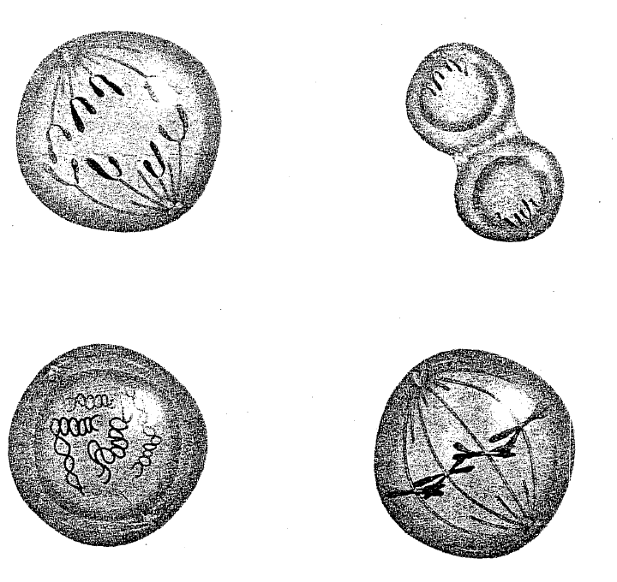
Suppose we had a cell with 4 chromosomes…

Slide 22
Differences Between Plant & Animal Cells
Plant
Animal

Slide 23
Answers to Fill-in-the-Blanks
“The Cell Cycle”
Reproduce cells
Interphase, chromatin, chromosome
Mitosis
  Prophase, disappear, spindle fibers, double stranded chromosome (called centromere)
  Metaphase, line (middle)
  Anaphase, contract, apart, opposite sides
  Telophase, DNA, spindle fibers, nuclear membrane, chromatin
  Cytoplasmic Division
  -sets of DNA (nuclei is also a great answer), cell membrane, cell plate
  Daughter cells (genetically identical), begins again

Slide 24
Diagram of Interphase

Slide 25
Diagram of Prophase

Slide 26
Diagram of Metaphase

Slide 27
Diagram of Anaphase

Slide 28
Diagram of Telophase

Slide 29
Diagram of Cell Division in an Animal Cell

Slide 30
Diagram of Cell Division in a Plant Cell

Slide 31
Answers
A |  |  | B
d | 1. Nucleolus appears within each new nucleus. |  | A. Prophase
c | 2. Centromeres divide. |  | B. Metaphase
f | 3. Chromosomes become visible. |  | C. Anaphase
a | 4. Spindle fibres begin to form. |  | D. Telophase
d | 5. DNA replicates. |  | E. Interphase
a | 6. Replicated strands move toward opposite poles. |  | F. Cytokinesis
b | 7. Chromosomes form a line across the middle of the cell.
d | 8. Nuclear membrane forms around each set of chromosomes.
f | 9. Cell grows.
a | 10. Centrioles move to opposite ends of the cell.
d | 11. Chromosomes separate and move toward poles of the cell.
a | 12. Nuclear membrane disappears.
f | 13. Cell membrane pinches together and the cytoplasm divides.
f | 14. Daughter cells form.
e | 15. It makes up most of a cell’s life.
b | 16. Chromosomes line up at the equator of the cell.

Slide 32
Answers
Structures Present | Interphase | Prophase | Metaphase | Anaphase | Telophase
Nucleus
Nucleolus
Nuclear Membrane
Chromatin
Chromosomes
Spindle fibres
.

Slide 33
Answers
1. List 4 different significant events of prophase? (give at least 4)
the nucleolus disappear
Nuclear membrane disappear
Spindle fibers appears
Spindle fibers attach to the centromere
2. What event marks the beginning of anaphase?
When the spindle fibers starts to pull the chromosomes apart.

Slide 34
Answers
3. Why are centrioles seen in the cell during mitosis?
They are seen because the spindle fibres are formed from the centrioles.
4. Why are spindle fibres seen in the cell during mitosis?
They are seen because the chromosomes are attached to the spindle fibers and the spindle fibres have to pull the chromosomes.
5. What are the chromosomes attached to during prophase, metaphase, and anaphase?
They are attached to the spindle fibres by the centromere.

Slide 35
Answers
6. Suppose a cell in interphase has 24 chromosomes before DNA replication. How many chromosomes does each daughter cell have after telophase? Explain.
24 chromosomes. The daughter cells will be the exact same as the parent cells meaning they also will have 24 chromosomes.
7. Are the cells made in mitosis HAPLOID or DIPLOID? ___________________________________
diploid

Slide 36
Answers
8. When mitotic cells were first observed, the cells in interphase were thought to be resting. Name at least 2 events that happen during interphase other than the cell resting.
-DNA is replicated
-chromosomes coils to form double helix
a) In mitosis, how many cells are created in total?
-double the original amount
b) What are these cells called?
-daughter cells

