Slide 1
Mon Sept 14 – Weds Sept 23
Mon Sept 14(Day 5) per 5
DNA – texts, 2 videos, prelabs assigned
Tues Sept 15 (Day 6) per 7,8
- Finish video
- Demo DNA Extraction
-Contracts signed
-Prelabs due by end of class today
-Vocabulary – 3 point approach
Thurs Sept 17 (Day 2) per 6
Pre-labs MAY be returned
Weds Sept 23 (Day 6) Per 7,8
DNA Extraction Lab

Slide 3
Inside a Cell
A Tour of the Chromosomes

Slide 4
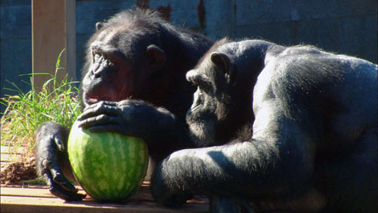
Humans, giraffes, chickens, gorillas or watermelons are made of
cells

Slide 5
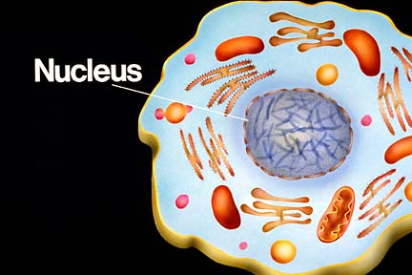
Inside every cell is
a nucleus

Slide 6
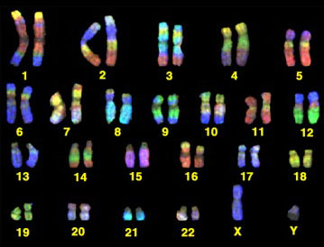
Inside every nucleus there are
chromosomes

Slide 7
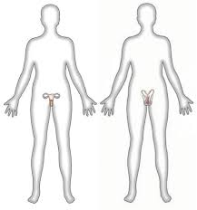
In humans there are
46 chromosomes in all BODY cells
23 chromosomes in all SEX cells
Testes contain sperm cells
(23 chromosomes)
Ovaries
contain
egg cells
(23 chromosomes)
(23 pairs)
(23 single chromosomes)

Slide 8
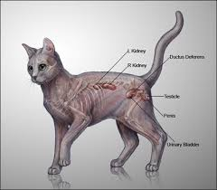
In cats there are
...and in the sex cells??????
38 chromosomes
in all body cells
19 chromosomes in all sex cells

Slide 9
Why would sex cells have half the number of chromosomes as body cells?
This is perfect! I have 19 chromosomes in my egg cells as well. Together we can make a new kitten 1 cell big ....
with 38 chromosomes!!
I only have 19 chromosomes in my sperm cells to give, my love!

Slide 10
Summary (copy this)

Slide 11
Complete Worksheet
Sex Cells – A Different Story
How Do Number of Chromosomes in Body Cells Compare to Sex Cells?

Slide 12
Sex cells – A Different Story
What’s MITOSIS???
Mitosis is a way of cells reproducing (making photocopies of themselves)
Meiosis is a way of making SEX cells
GAMETE is another word for sex cell (egg or sperm)

Slide 13
Vocabulary
Chromosome
Double helix
Nitrogen base
gene

Slide 14
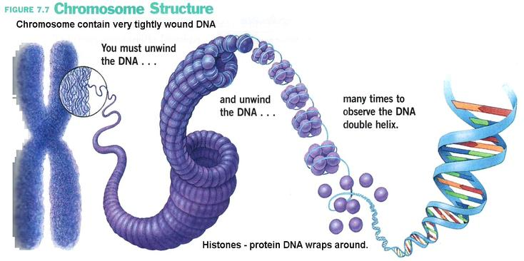
Each chromosome is made of
DNA

Slide 15
DNA
is Deoxyribonucleic acid
It is the molecule that chromosomes are made of.
In one chromosome there is about 2 meters of DNA (in a human body there are 3 trillion cells so there is 10-20 billion miles of DNA)

Slide 16
DNA: Double Helix
http://www.youtube.com/watch?v=VegLVn_1oCE&safe=active
Also a cool video → https://www.youtube.com/watch?v=2HgL5OFip-0
Watson was a _________________. Crick was a __________________. They worked at Cambridge in England.
What did Rosalyn Franklin contribute to the discovery of DNA?
Structure of DNA
Describe the structure of DNA.

Slide 17
Scientists Who Discovered DNA
Watson was a _________________. Crick was a __________________. They worked at Cambridge in England.
What did Rosalyn Franklin contribute to the discovery of DNA?

Slide 18
Lab Groups
Safety
Groups
1 Dong, Zach, Jenna-excellent 7Elise, Aminat, Camryn excellent
2 Liam, Sterling 8 Tia, Xuejun – excellent! G,G
Stupendous! write-up left behind
3 Sandro, Lem, Tobi excellent – G,G 9Daniel , Syed, Arslan- GSS
4 Sihan, Bradian, Nathan –GSS
5 Chaeyeon, Sheila, Cleo – fantastic!
6 Joanne, Laila, Dana – kiwi bag in recycling????
Chasity, Laila, Joanne – write-up

Slide 19
Structure of DNA
Describe the structure of DNA.

Slide 20
Video
Handout
http://www.youtube.com/watch?v=Wou1Udu_vr8

Slide 21
Mon Sept 28 – Fri Oct 2
Mon Sept 28 (Day 3) per 5
DNA “Quiz”
Tues Sept 29 (Day 4) per 1,7
-Contracts signed
-Vocabulary – 3 point approach
Weds Sept 30 (Day 5)
Thurs Oct 1 (Day 6) per 7,8
Mon Oct 5 (Day 2) Per 6
Tues Oct 6 (Day 3) per 5

Slide 22
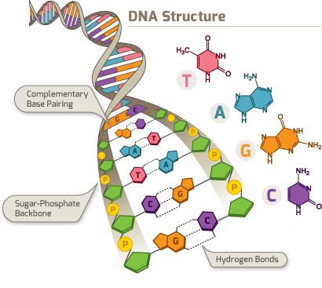
Source: Retrieved September 17, 2015 from http://www.thednall.com/images/what_img2.png

Slide 23
Structure of DNA
Describe the structure of DNA.
Double helix (twisted ladder)
Phosphate and sugar “backbone”
4 nitrogen bases
Adenine (A)
Thymine (T) A & T always pair together
Cytosine (C)
Guanine (G) C & G always pair together

Slide 24
Worksheet: DNA “Quiz”
1) DNA
2) nucleotide
3) copied
4) nitrogen bases
5) C (cytosine) G (guanine), A (adenine), T (thymine)
6) (top) A, T, C
(bottom) G, C
7) bases

Slide 25
DNA “Quiz”
8) DNA is used to make proteins
9) A GENE is a portion of a chromosome ( a segment of DNA) that holds the code for a certain protein
10) DNA can be used to solve crimes because each human has a unique set of DNA
(except identical twins)

Slide 26
DNA can be unzipped & copied
http://www.bing.com/videos/search?q=how+DNA+makes+proteins&FORM=VIRE7&adlt=strict#view=detail&mid=E5C5BB496C677BB1103DE5C5BB496C677BB1103D
http://www.bing.com/videos/search?q=Protein+Synthesis+Crash+Course&Form=VQFRVP&adlt=strict#view=detail&mid=B9451DBB53E455D382C7B9451DBB53E455D382C7

